Slide 1


SİS POWER
Sadık AKYAR İsmail ATASEVEN Sonay ULUKAYA

Slide 2
Flyback Converter
Input Voltage Range: 24V-48V
Output Voltage: 10V
Output Power: 60W
Output Voltage Ripple: %4
Line Regulation: %2
Load Regulation: %2

Slide 3

SIMULATION RESULTS

Slide 4
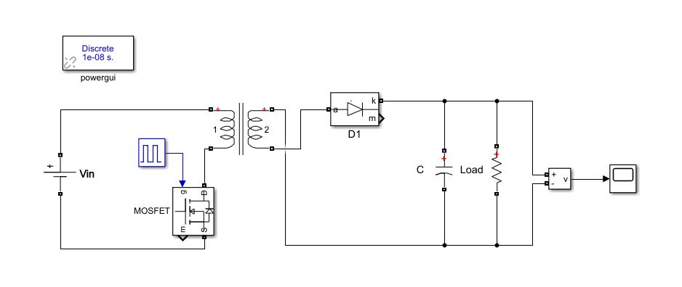
Cırcuıt schematıc

Slide 5


For Vın = 24 V
Average output voltage: 9.99V
Output voltage ripple: 0.09V (%0.9)

Slide 6
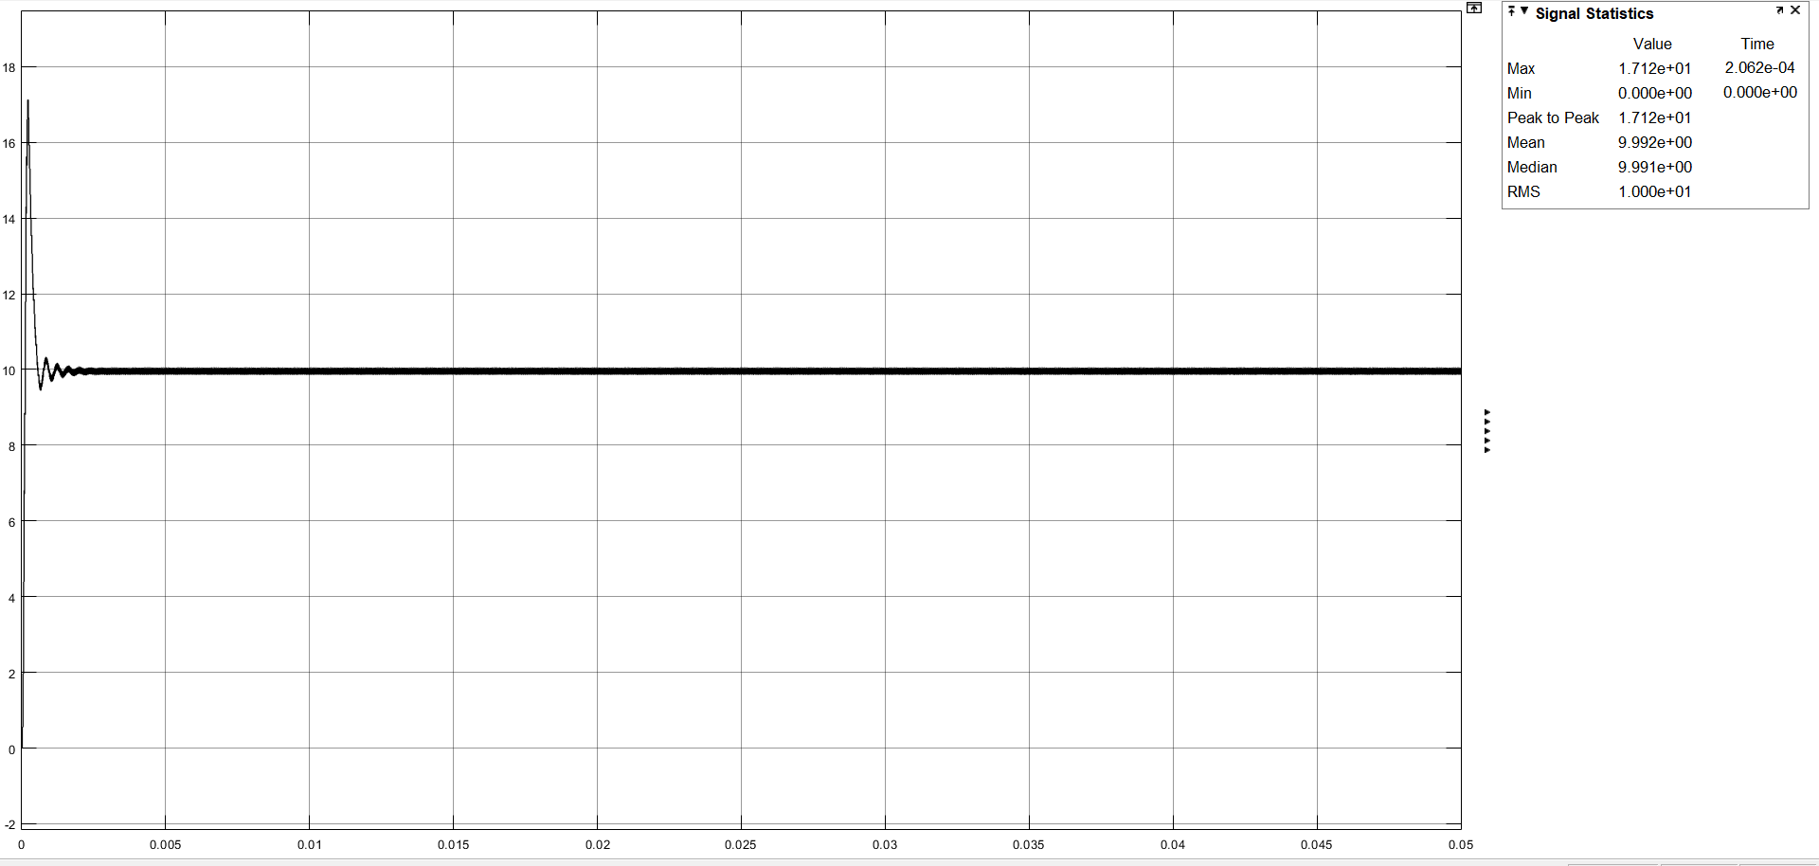
Output Voltage

Slide 7
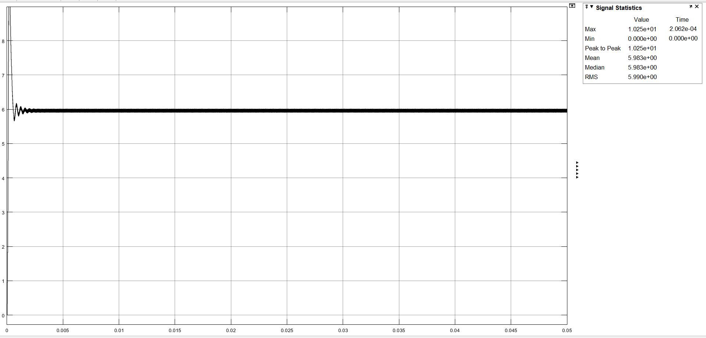
Output Current

Slide 8
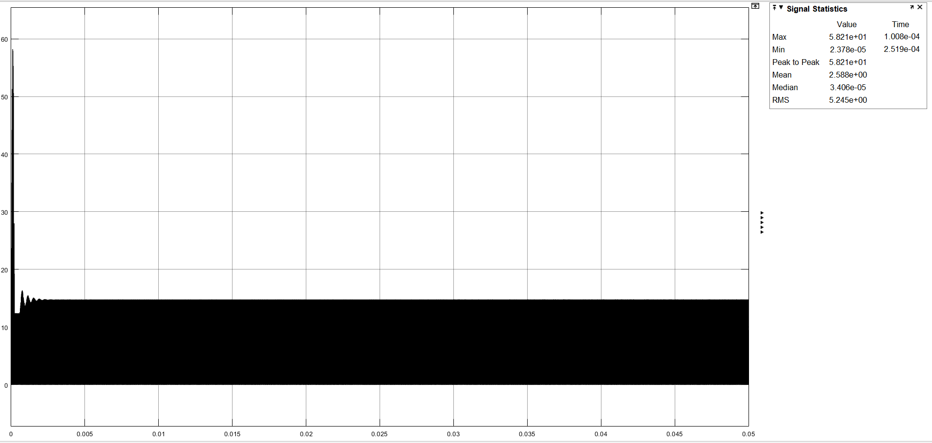
Input Current

Slide 9
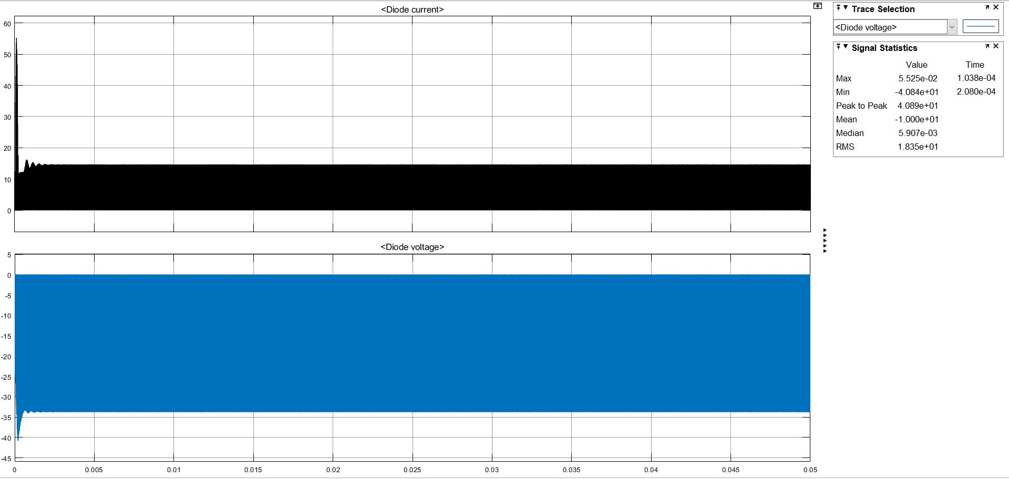
Diode Current and Voltage

Slide 10
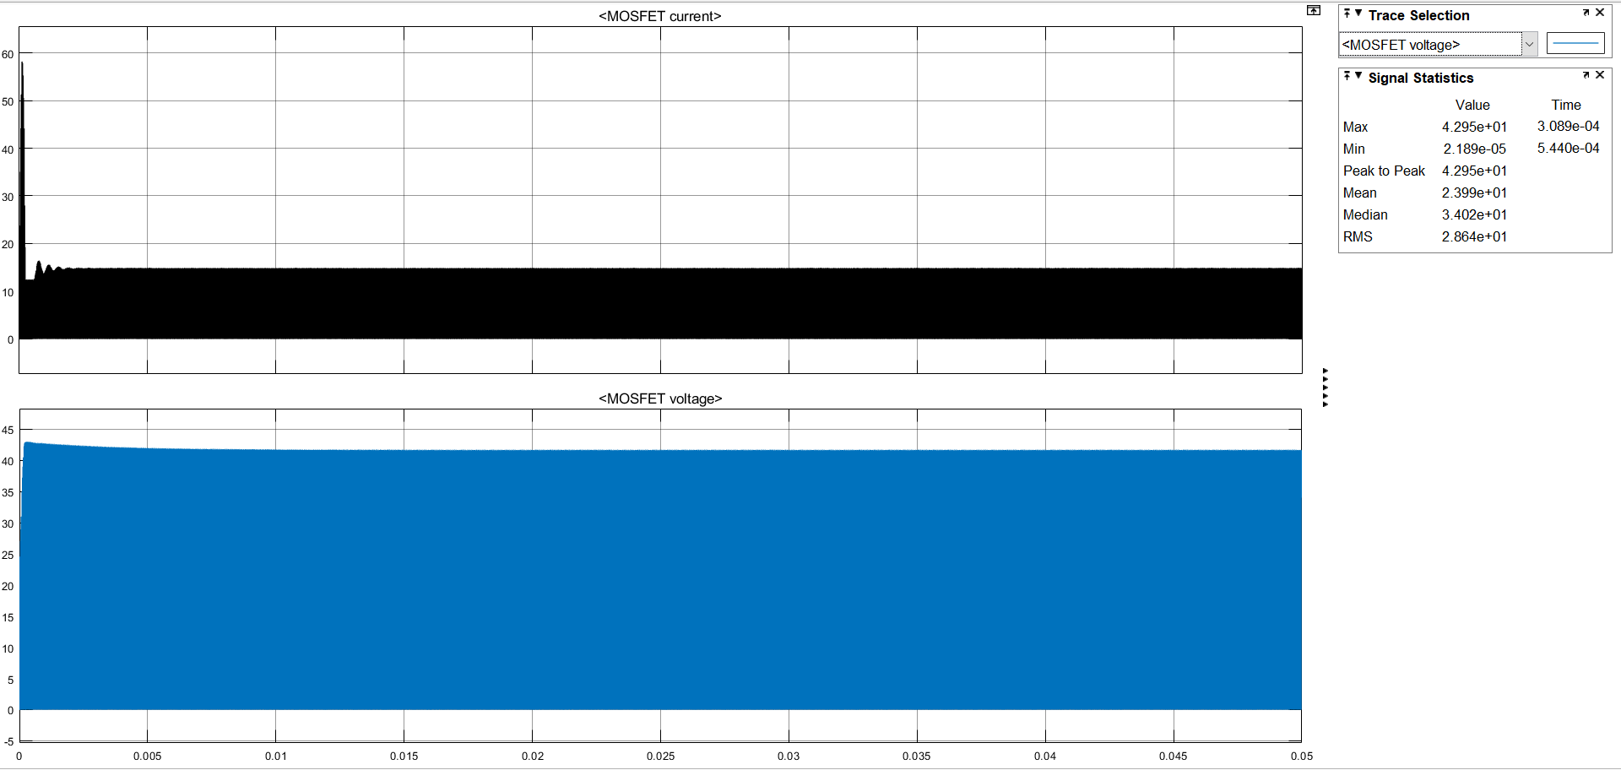
MOSFET Current and Voltage

Slide 11
For Vın = 48 V
Average output voltage: 10.03V
Output voltage ripple: 0.053V (%0.528)

Slide 12

Output Voltage

Slide 13
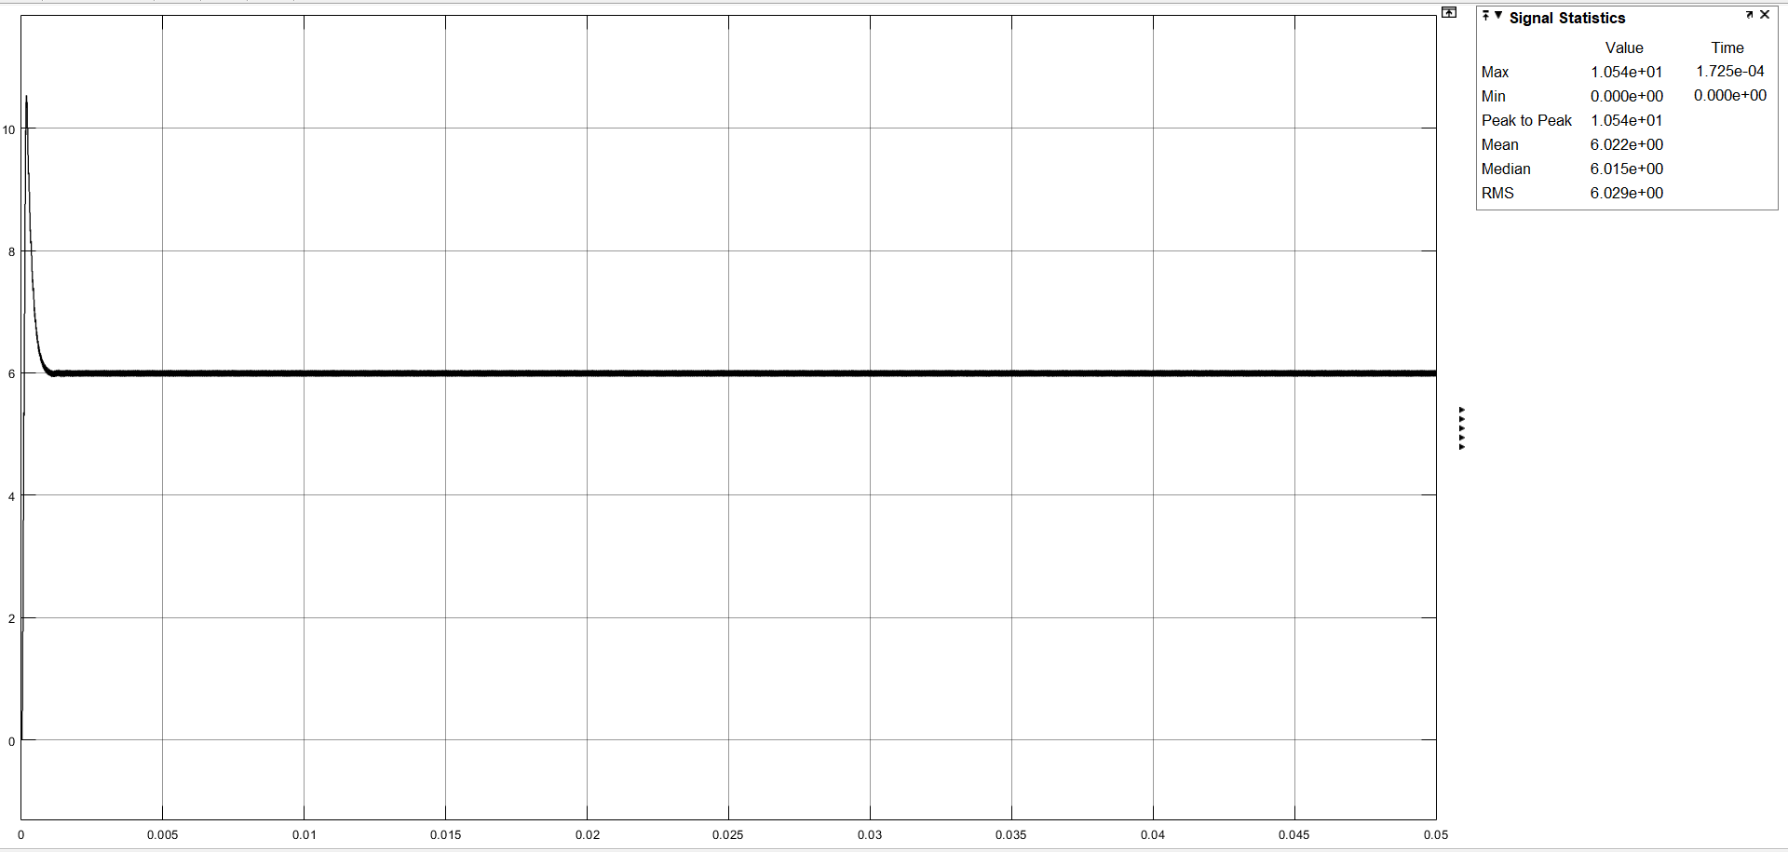
Output Current

Slide 14

Input Current

Slide 15

Diode Current and Voltage

Slide 16
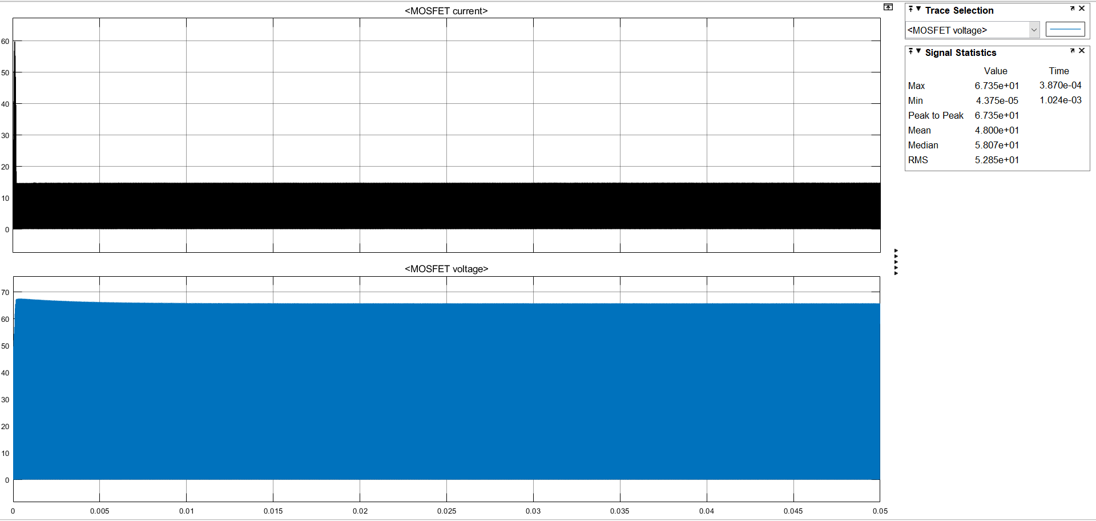
MOSFET Current and Voltage

Slide 17
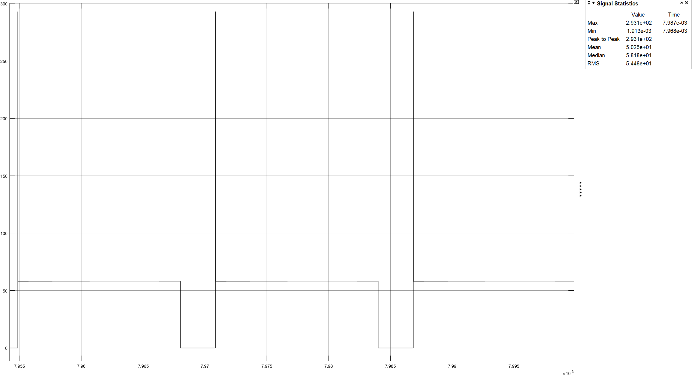
Wıthout snubber

Slide 18
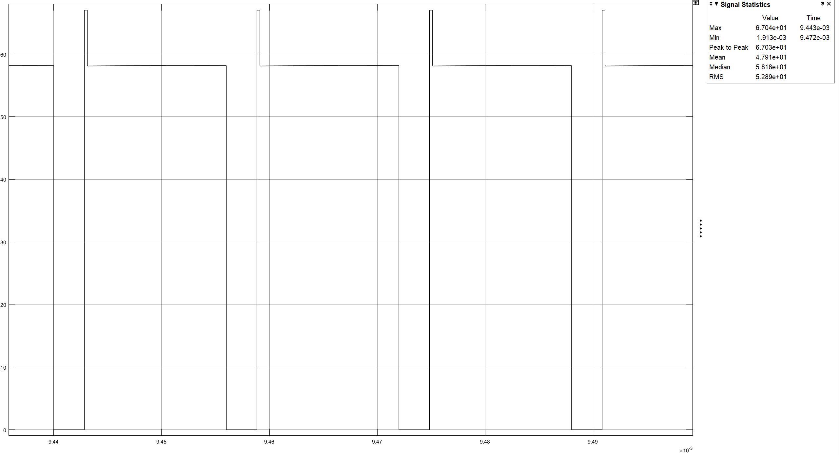
Wıth snubber

Slide 19
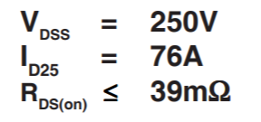
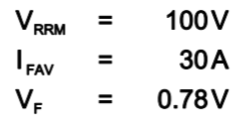
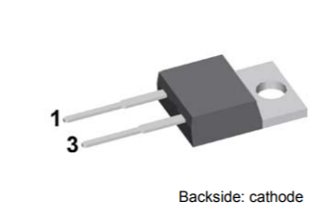
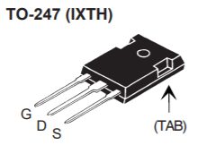
Chosen mosfet & dıode
Mosfet-IXTH76N25T;
Diode-IXYSDSA30I100PA

Slide 20
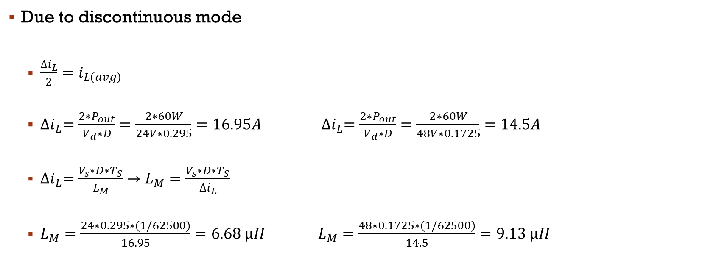
Magnetıc Desıgn
Due to discontinuous mode
$\frac{∆i_{L}}{2}=i_{L\left(avg\right)}$
${∆i}_{L}=\frac{{2∗P}_{out}}{V_{d}∗D}=\frac{2∗60W}{24V∗0.295}=16.95A {∆i}_{L}=\frac{{2∗P}_{out}}{V_{d}∗D}=\frac{2∗60W}{48V∗0.1725}=14.5A$
${∆i}_{L}=\frac{V_{s}∗D∗T_{S}}{L_{M}}→L_{M}=\frac{V_{s}∗D∗T_{S}}{{∆i}_{L}}$
$L_{M}=\frac{24∗0.295∗(1/62500)}{16.95}=6.68 µH L_{M}=\frac{48∗0.1725∗(1/62500)}{14.5}=9.13 µH$

Slide 21
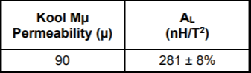
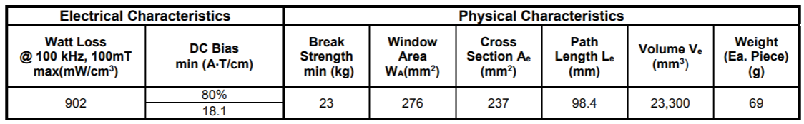
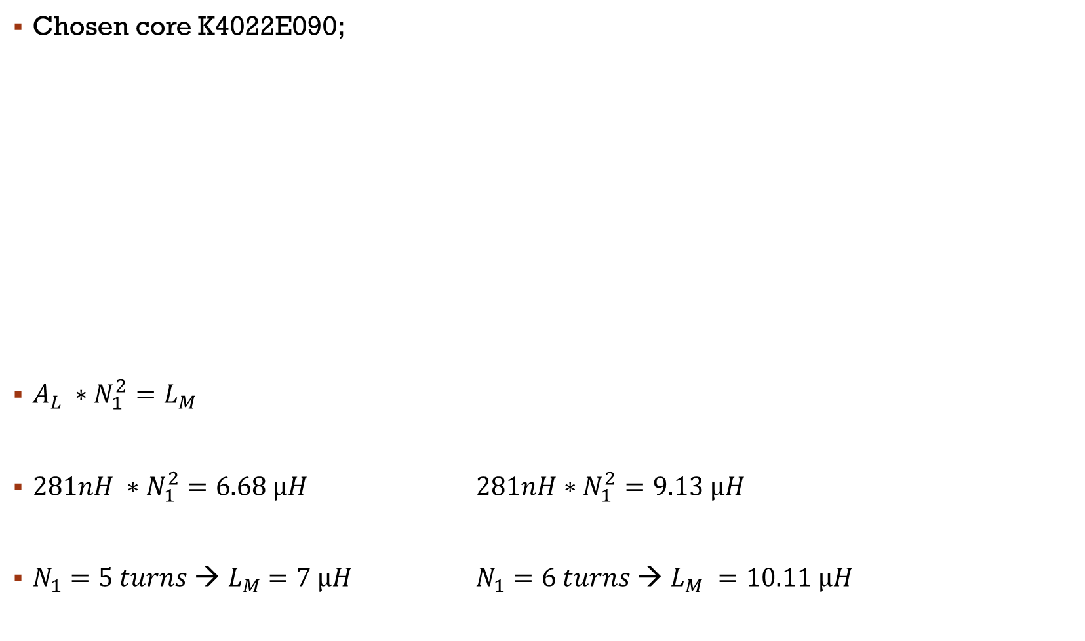
Chosen core K4022E090;
$A_{L} ∗N_{1}^{2}=L_{M}$
$281nH ∗N_{1}^{2}=6.68 µH 281nH∗N_{1}^{2}=9.13 µH$
$N_{1}=5 turns$ → $L_{M}$ $=7 µH$ $N_{1}=6 turns \text{→} L_{M} =10.11 µH$

Slide 22
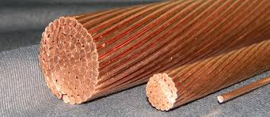

Chosen AWG-18 cable properties;
R=20.95 mΩ/m
I(max)=16A
Area=0.823 ${mm}^{2}$
Passing max. Current = 8.475A
One turn length = 63.8 mm
$Copper Loss=\left(I^{2}\right)∗R$
$={8.475A}^{2}∗\left(20.95\text{m}\text{Ω}\text{/}\text{m}\text{∗0.0638}\text{m}\text{∗}6t\right)$
$=$67.9mW
$k_{fill−factor}=\frac{N∗Cable area}{Window area}∗100$
$$=\frac{6∗\left(0.823{mm}^{2}\right)}{\left(9.27mm\right)∗\left(14.9mm\right)∗2}∗100=1.7\%$$

Slide 23

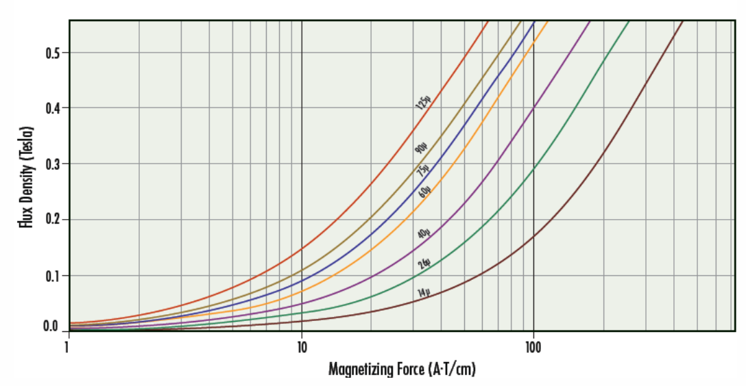

$N∗I=B∗A∗R\left(reluctance\right)$
6$∗14.5A=B∗\left(237∗{10}^{−6}{mm}^{2}\right)∗\left(3670024.515\right)$
$B=0.1T$

Slide 24
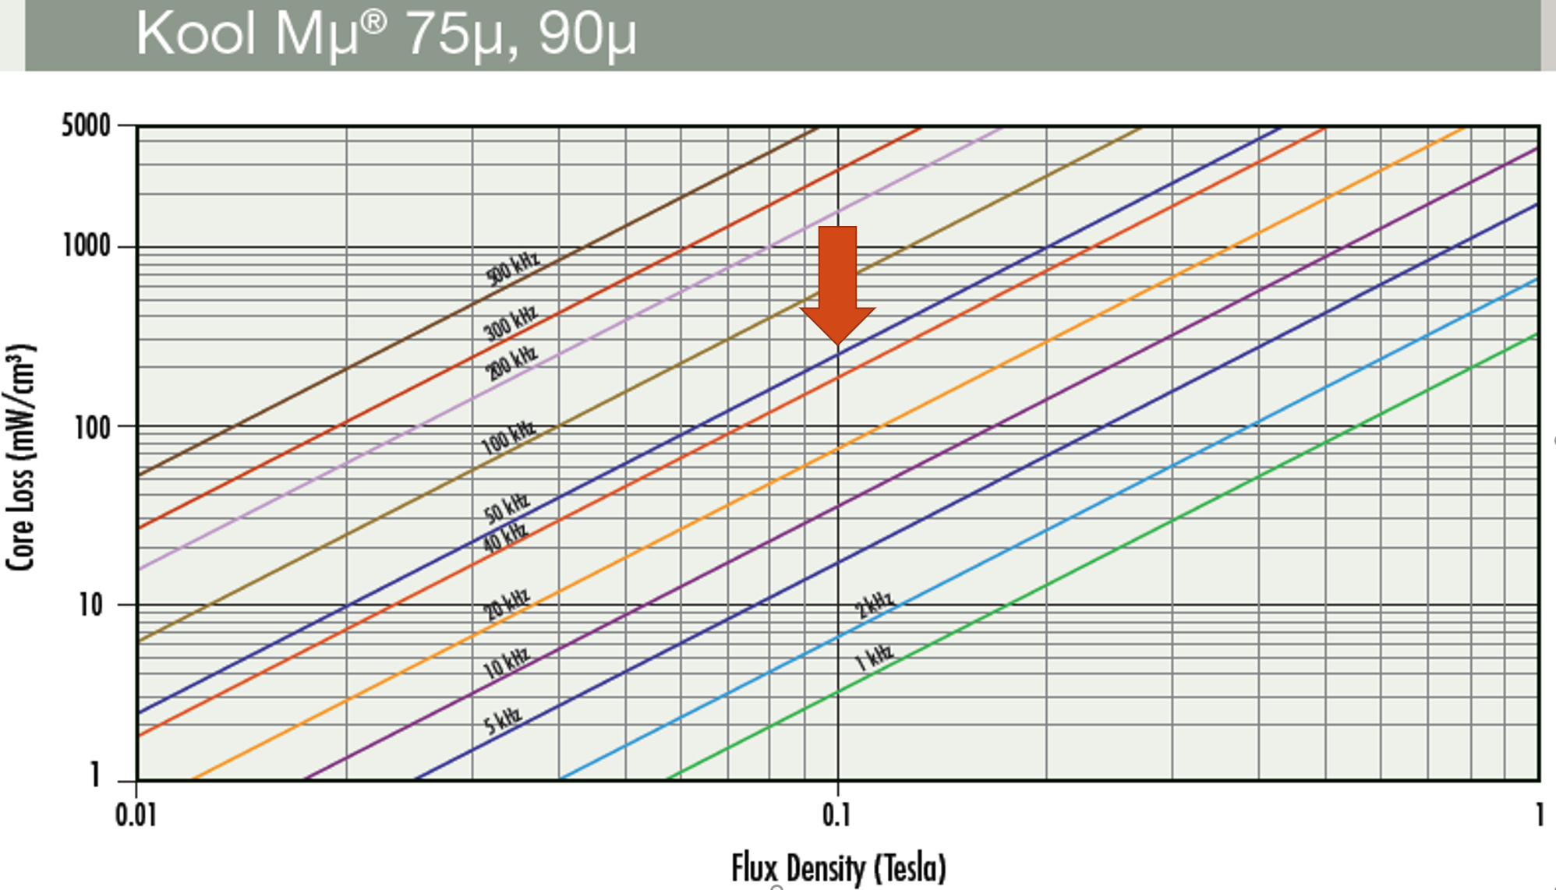

$Core Loss=Volume∗Core loss multiplier$
$Core loss=\left(23300{mm}^{3}\right)∗\left(\frac{250mw}{{cm}^{3}}\right)=5.8W$

Slide 25
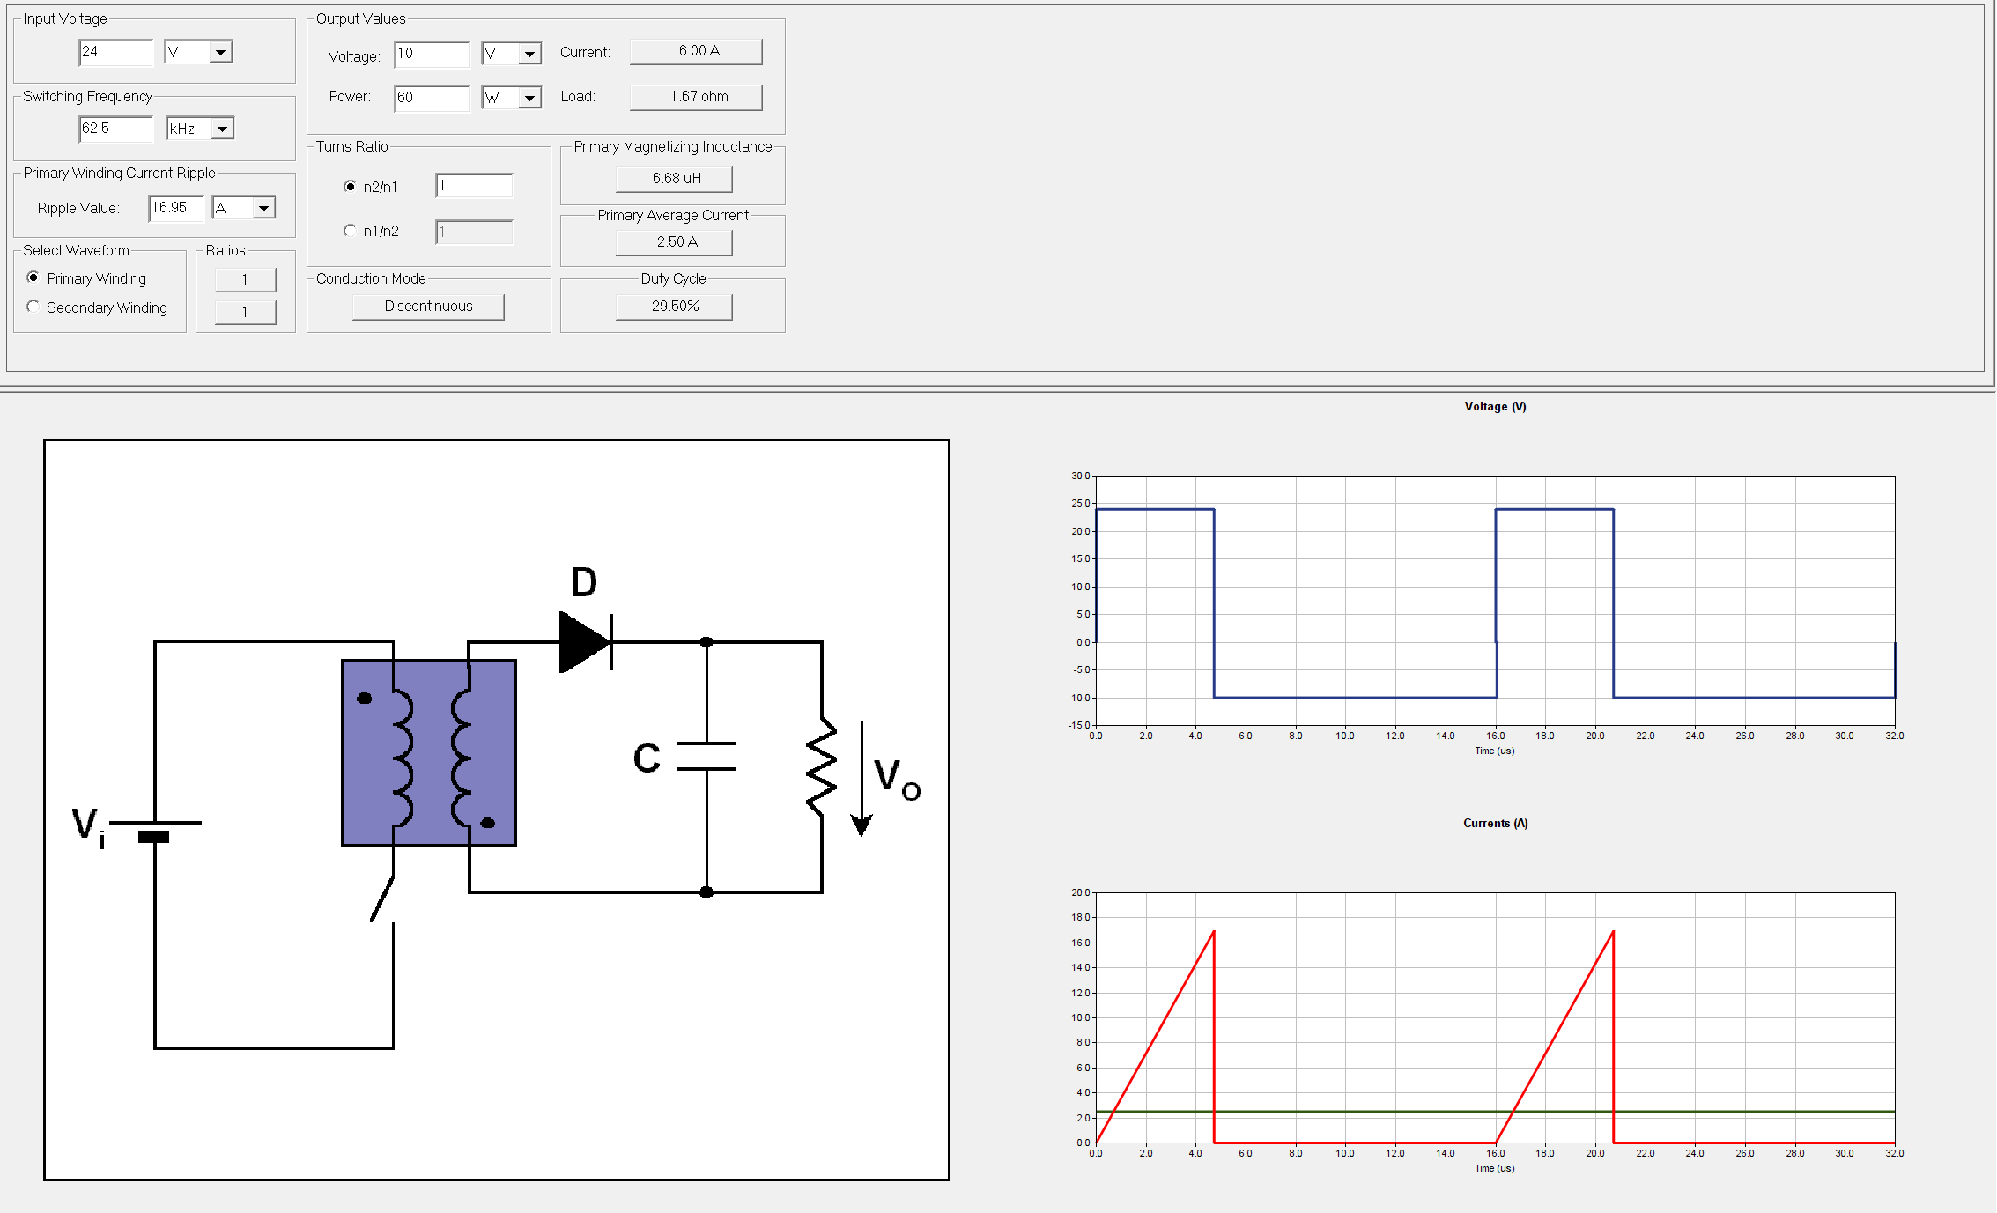
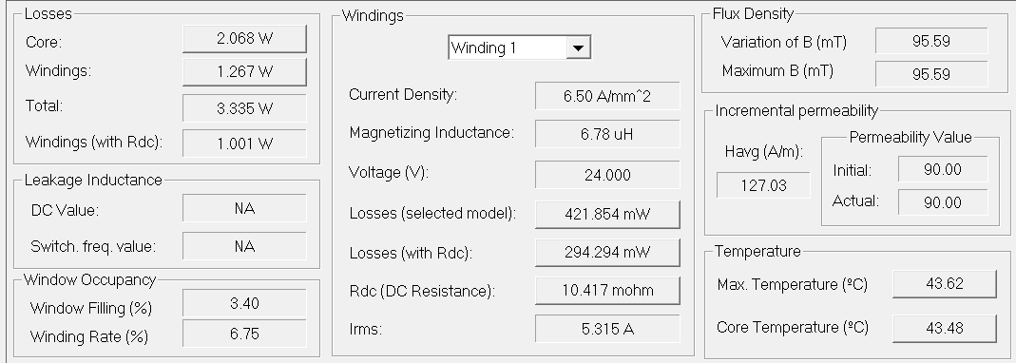
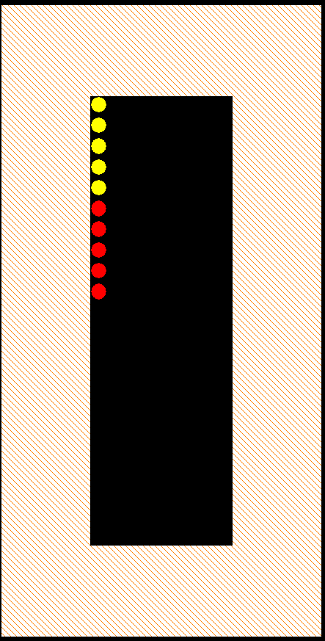
PExprt

Slide 26
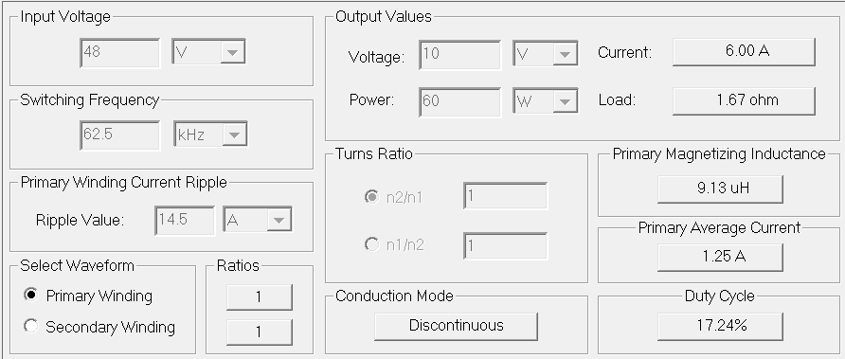
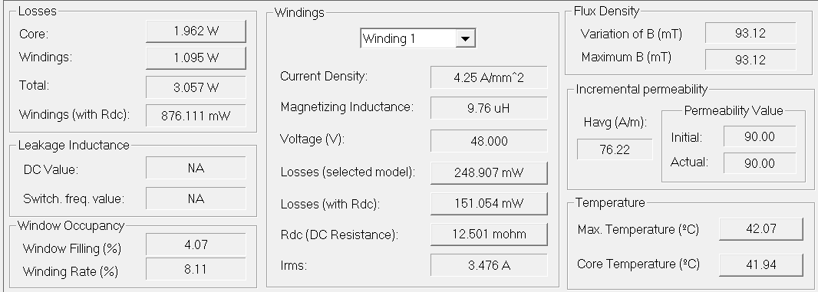
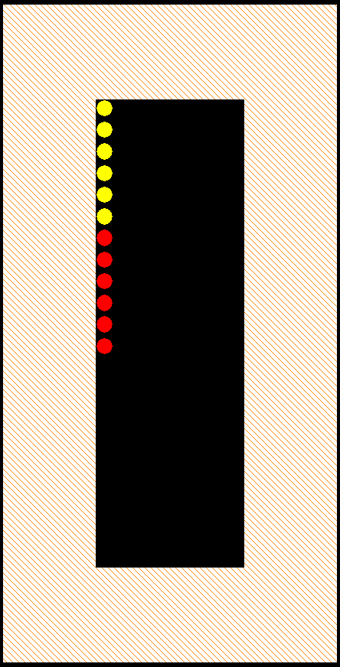
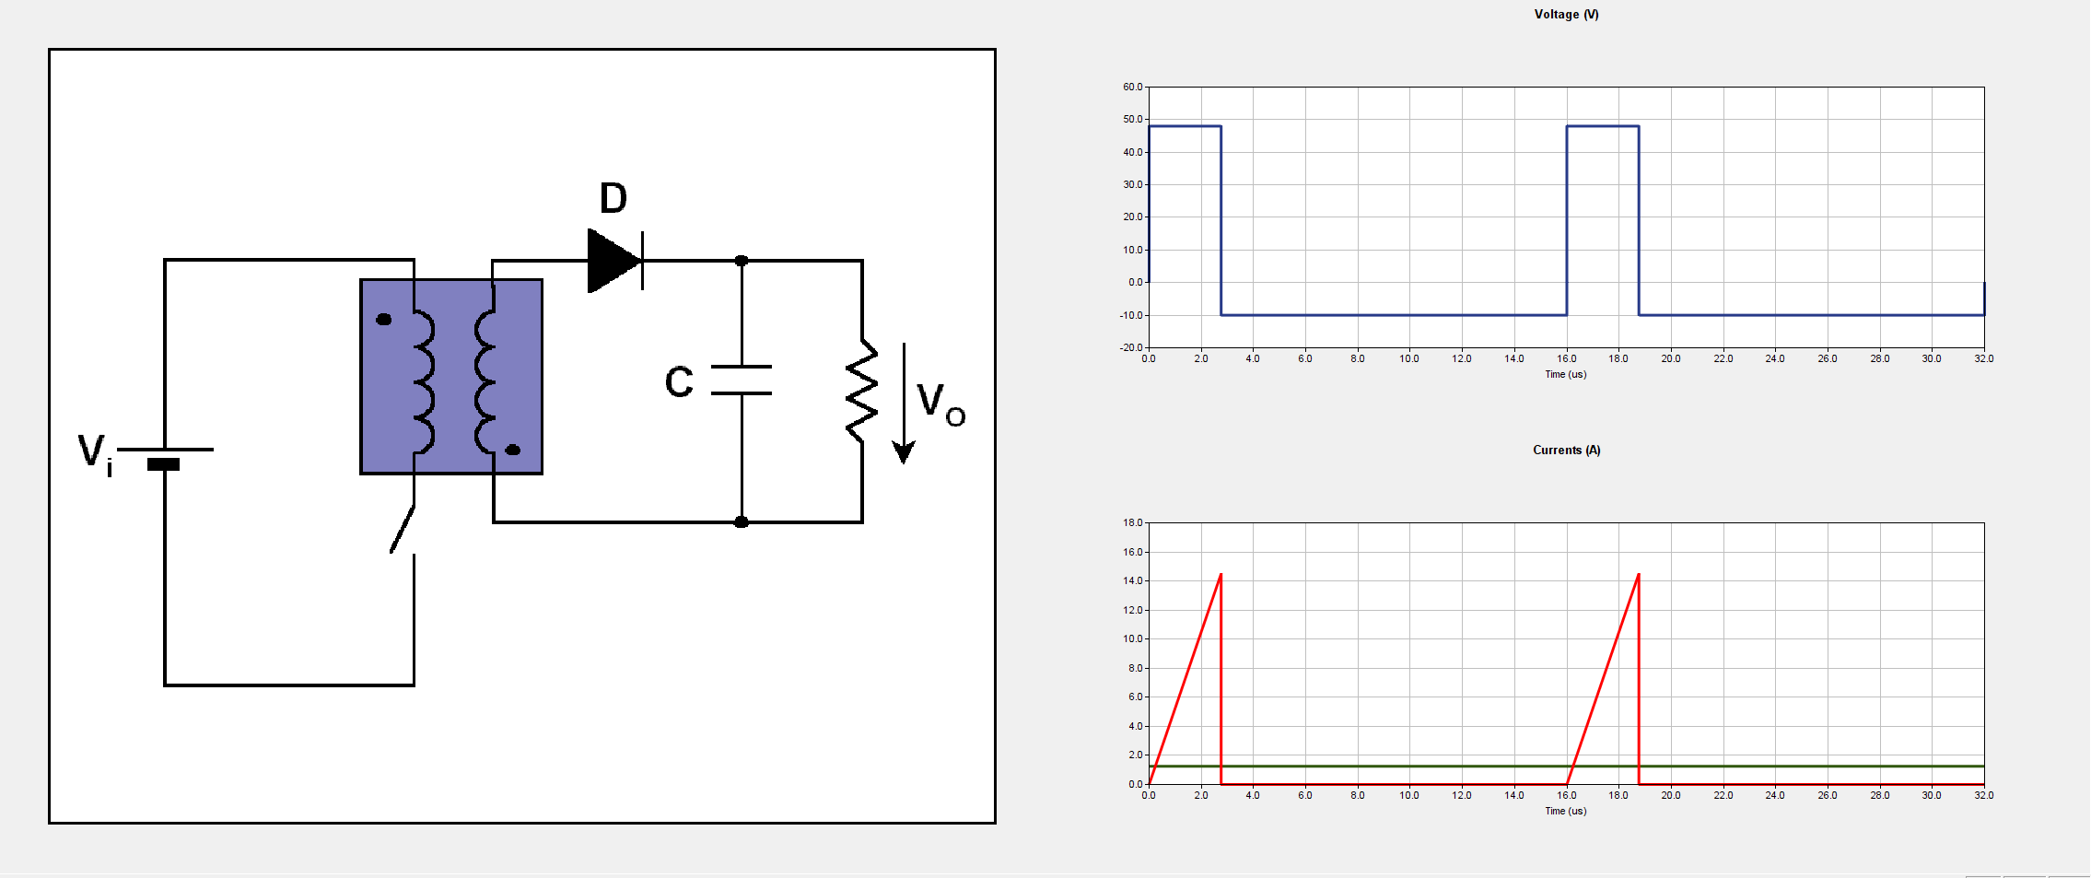
PExprt

Slide 27
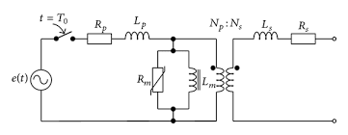
Transformer equıvalent cct model

Slide 28
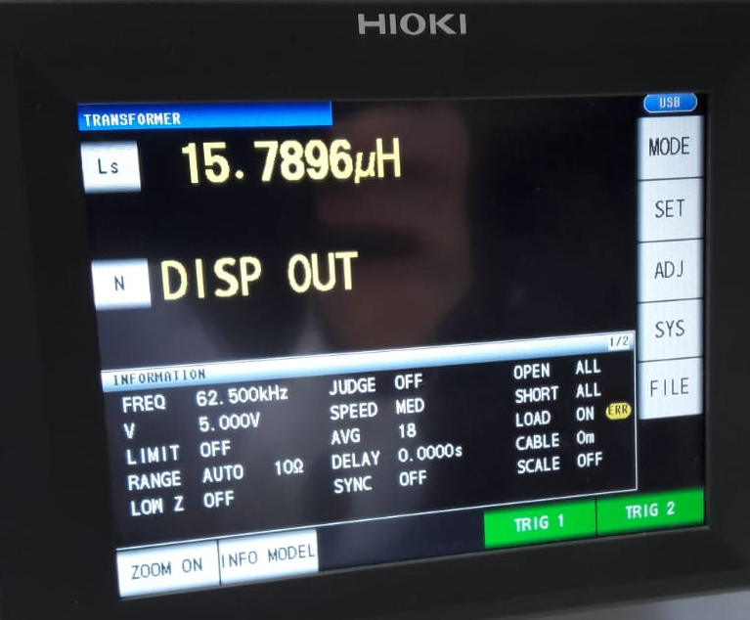
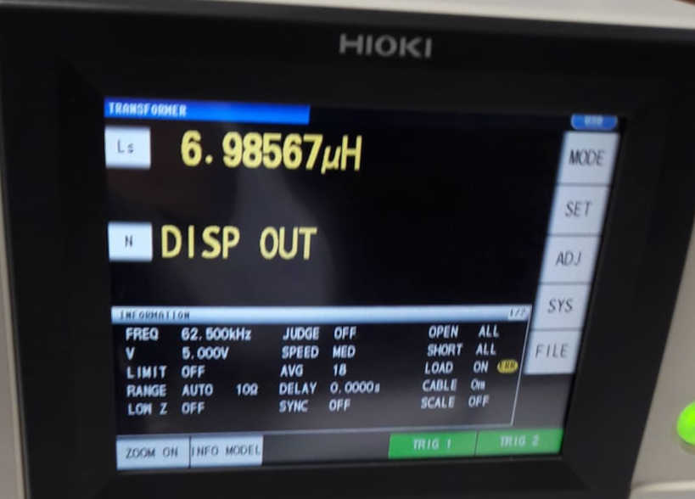
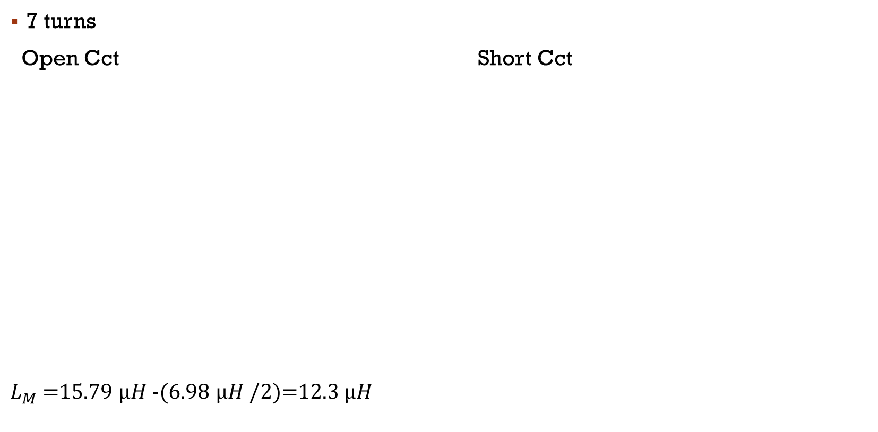
Test results
7 turns
Open Cct Short Cct
$L_{M}$ =15.79 $µH$ -(6.98 $µH$ /2)=12.3 $µH$

Slide 29
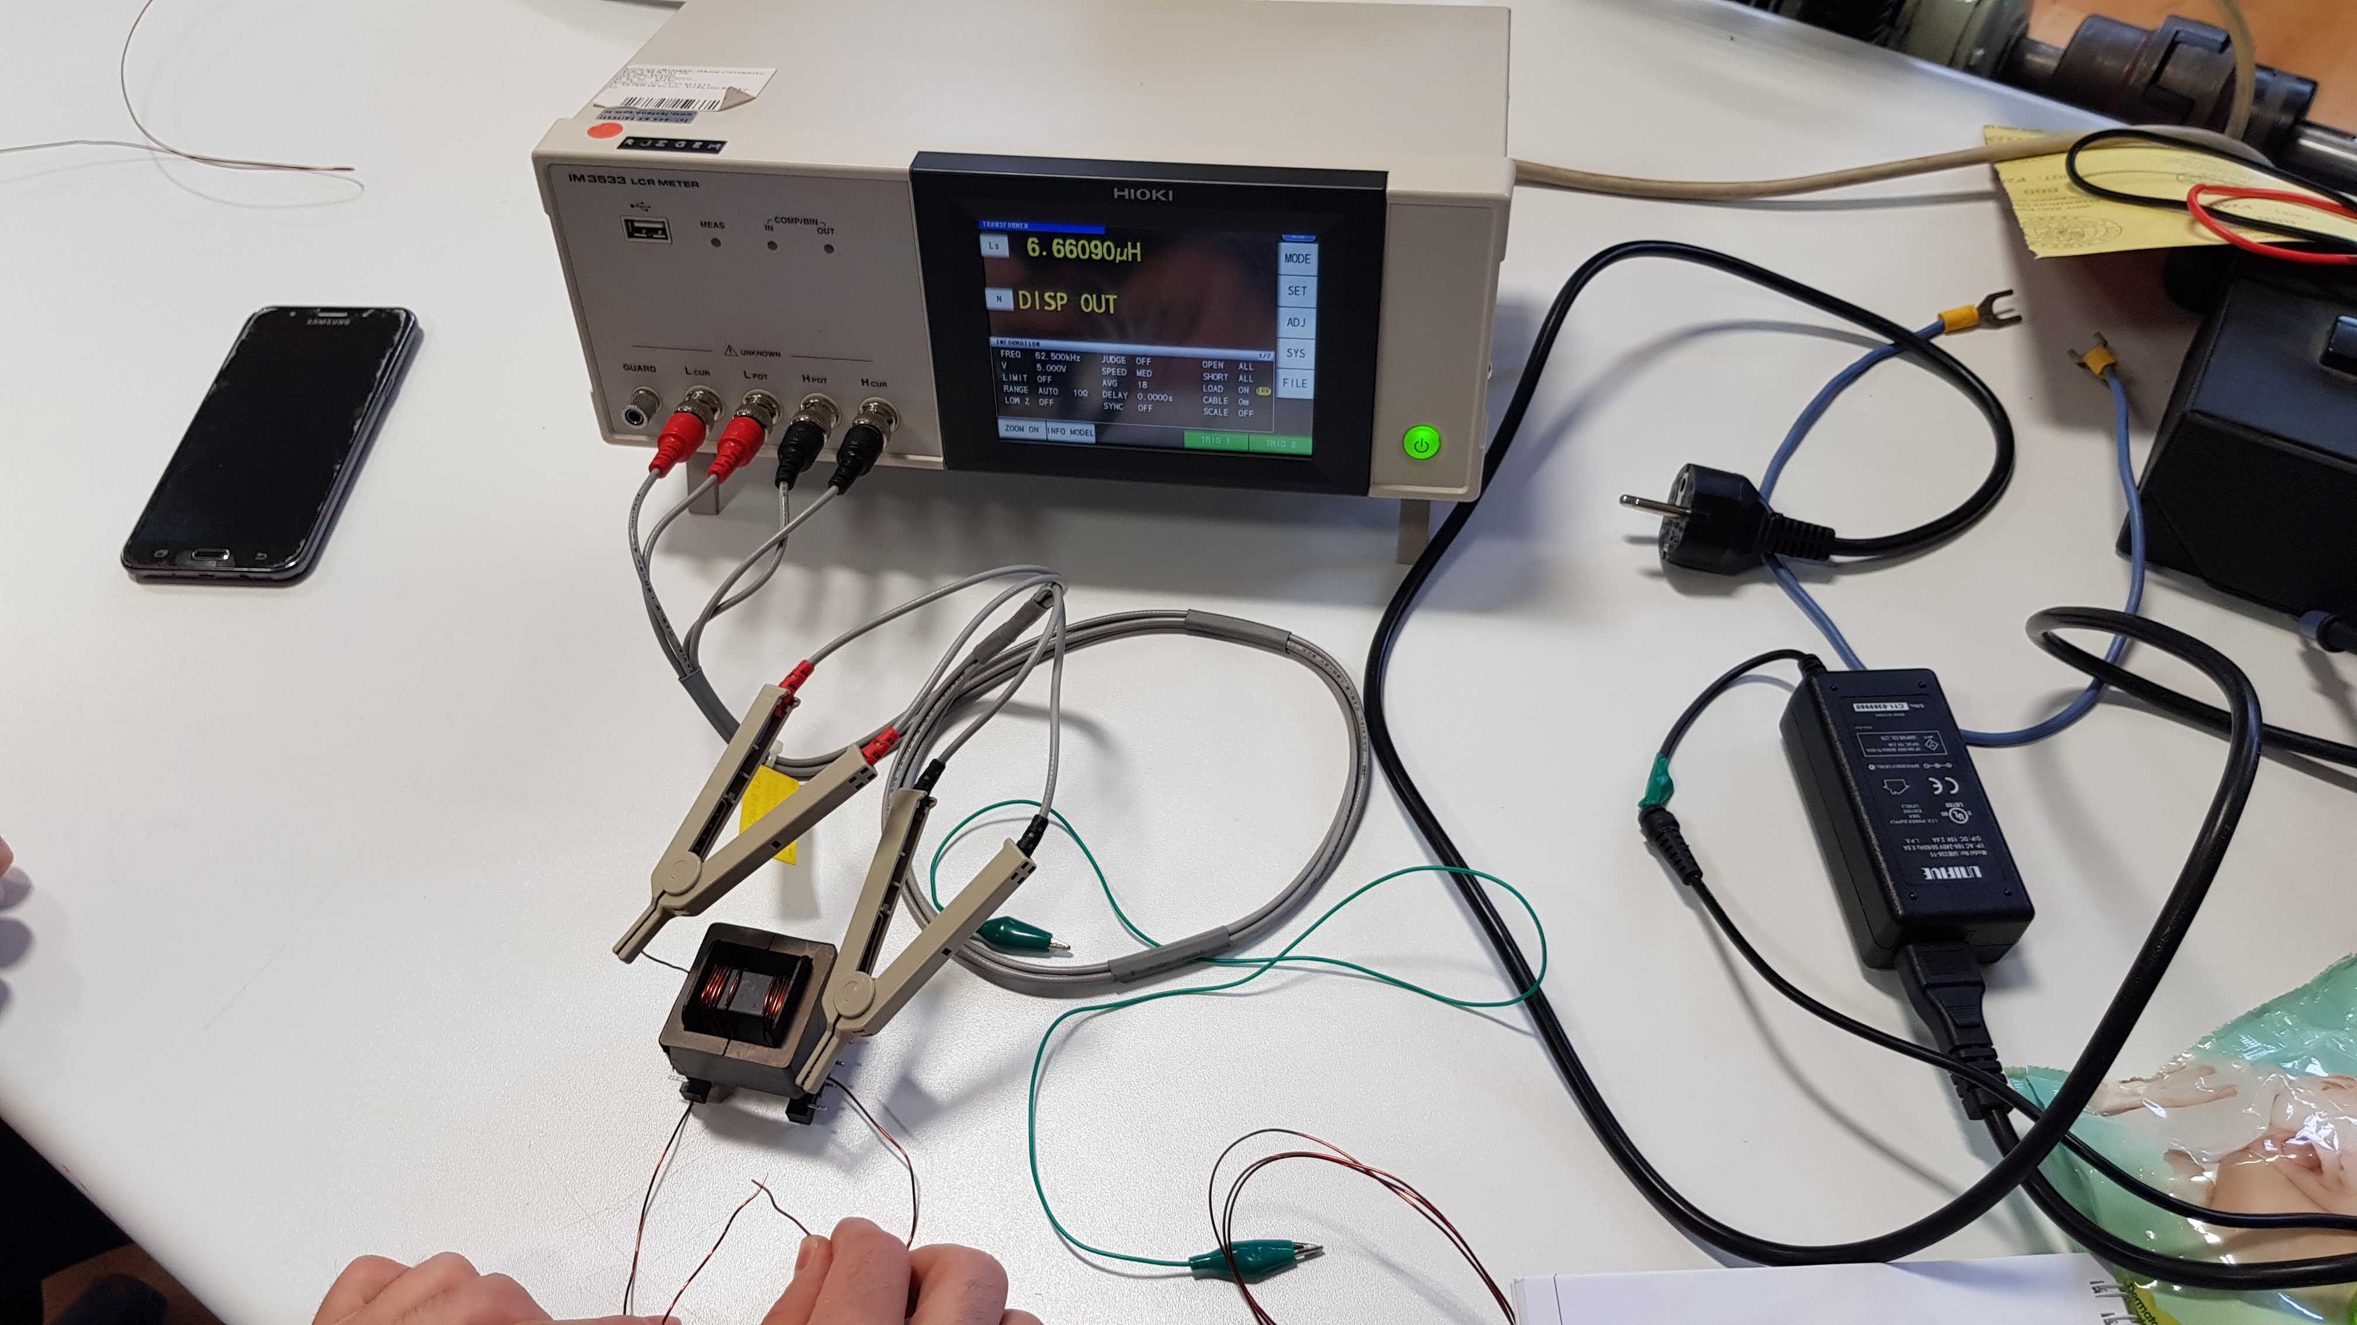
Test setup

